Slide 1
Quantum Cryptography
By: Michael Chillemi

Slide 2
Quantum Computers
Quantum computing uses “quantum bits” which can be represented as a one, zero, or both at the same time.
A major threat to security
By 2030, the number of quantum computers worldwide could be between 2,000 and 5,000
Only a few seconds needed for the AI to learn
Solve very complex problems a lot faster than supercomputers

Slide 3
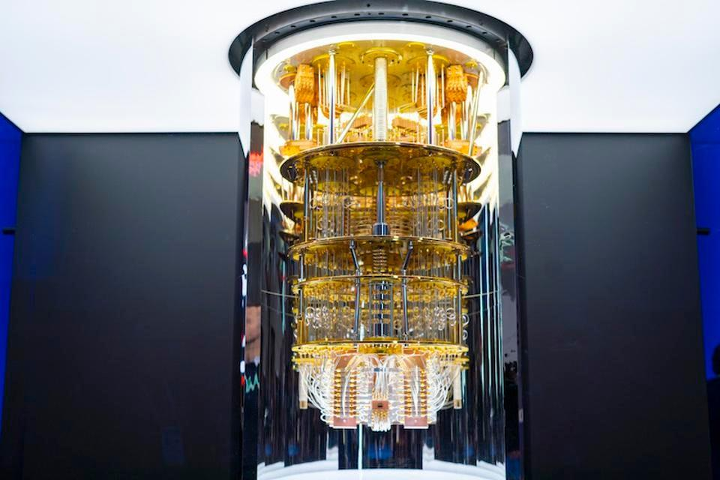
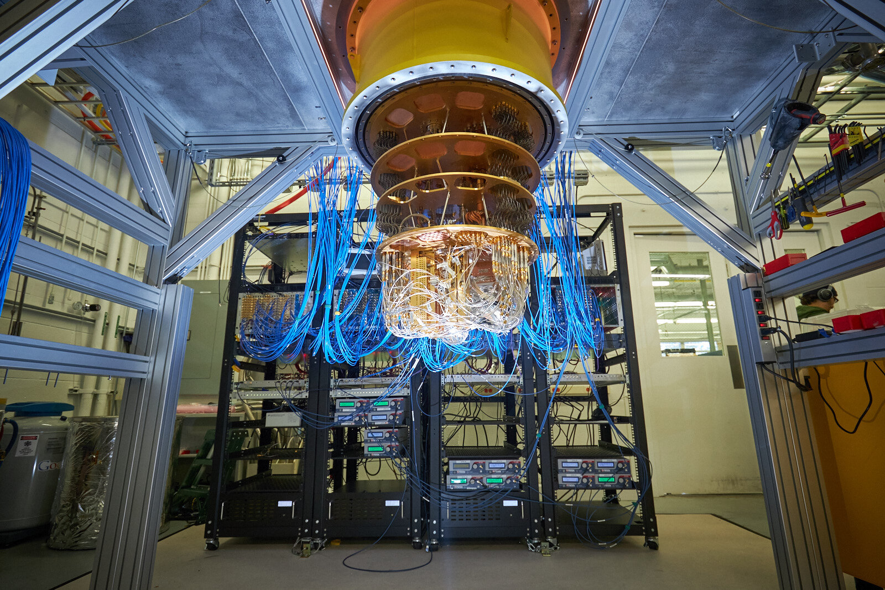
The Effect of Quantum Computers
Break all modern day cryptography

Slide 4
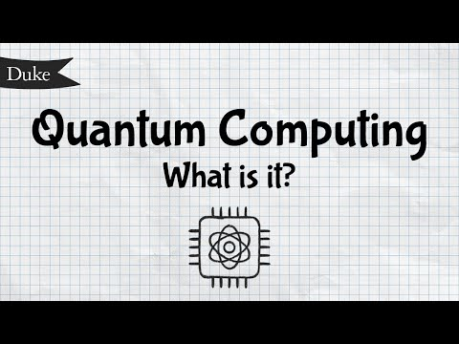
Quantum Computing Video

Slide 5
Quantum Cryptography
Started in the 1980s
Uses quantum mechanics to encrypt data
Can not measure quantum property without changing or disturbing it
You are able to clone quantum properties of a particle but not the whole particle
Uses public key algorithms
Traditional Computers take months or years to break
Using Shor’s they will have the ability to break it in moments

Slide 6
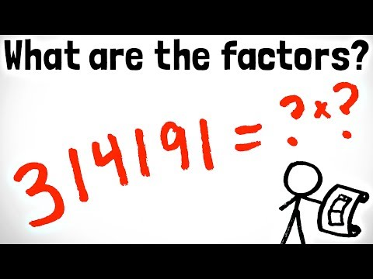

Shor’s Algorithm
Quantum computer algorithm for finding prime factors of N
Discovered in 1994 by Peter Shor

Slide 7

Quantum Key Distribution
Secure communication method
Uses quantum physics not math to encrypt data
When the photons arrive at the endpoint the receiver uses beam splitters to read the polarization of each photon

Slide 8
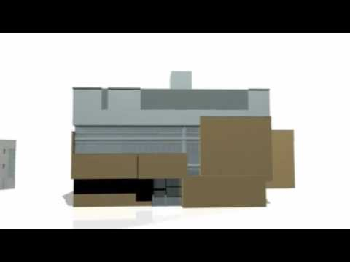
Quantum Key Distribution Video

Slide 9
Benefits
Detect any type of intrusion
Fragile photons they will change if anyone try to eavesdrop
Random key generated
Simple to use
Less resources needed to maintain it
Performance of quantum key distribution is continuously improving

Slide 10
Disadvantages
World wide implementation can take many jobs
Leads to unemployment
While traveling photons can change various ways
Lacks digital signature
High cost
Impossible to send more than 2 keys to different locations(multiplexing is against quantum principals)
Largest recorded distance 509 km (316.278 miles)

Slide 11
Sources
Daniel Bernstein, and Tanja Lange, (2017). Post-quantum cryptography. Nature (London),549(7671), 188-194. https://dio.org/10.1038/nature23461
Anne Broadbent, and Christian Schaffner, (2016). Quantum cryptography beyond quantum key distribution. Designs, Codes, and Cryptography, 78(1), 351–382. https://doi.org/10.1007/s10623-015-0157-4
Diogo Lima, and Gustavo Rigolin, (2020). Asymptotic security analysis of teleportation-based quantum cryptography. Quantum Information Processing, 19(7). https://doi.org/10.1007/s11128-020-02701-w
Neha Sharma, and Ramkumar Ramachandran, (2021). The emerging trends of quantum computing towards data security and key management. Archives of Computational Methods in Engineering, 28(7), 5021–5034. https://doi.org/10.1007/s11831-021-09578-7
Kexin Wang, Xinke Tang, Adrian Wonfor, Robert Collins, Gerald Buller, Richard Penty, Ian White, and Xu Wang (2021). 40Gbits−1 Data transmission in an installed optical link encrypted using physical layer security seeded by quantum key distribution. Journal of Lightwave Technology, 39(19), 6130–6141. https://doi.org/10.1109/JLT.2021.3095539

Slide 12
Thank You

